Slide 1



Siskiyou County
2021 Redistricting
Notes:
Intro

Slide 2

Welcome

Slide 3
Board of Supervisors
District 1
Brandon Criss
District 2
Ed Valenzuela
District 3
Michael N. Kobseff
District 4
Nancy Ogren
District 5
Ray A. Haupt
Notes:
Who is in charge of redistricting
To assist with the completion of a redistricting study in an inclusive, transparent, and comprehensive manner, and in order to garner community input on redistricting, the Board of Directors established a Redistricting Advisory Committee.
The Committee consists of seven members, with each Board member appointing one member.

Slide 4
Agenda
Things we will cover:
  Redistricting Basics
  Traditional Redistricting Principles
  Communities of Interest
  Map Tool Demonstration
  Public Hearing Schedule

Slide 5
What is Redistricting
Definition
Redistricting is the process of adjusting district lines every 10 years after the release of the U.S. Census. The well-known examples are Congressional and State Legislative Districts, but local governments also must do redistricting.
  Siskiyou County also must go through this process, as it did in 2011, to ensure the supervisorial districts are rebalanced after the decennial census.
  Beyond creating districts of equal population, redistricting also serves to empower local communities and preserve voting rights.
Notes:
Having balanced districts ensures every community is represented fairly
When people think of redistricting, they usually go to state level and congressional redistricting, but local governments also go through this process.
Redistricting on the county level affects your community and it is important that community members are involved in this process so they can have input on how their neighborhoods are drawn
Redistricting ensures districts are balanced in regards to population, but it also serves to empower communities and preserve voting rights

Slide 6
Traditional Redistricting Principles
Preventing a District from becoming a Gerrymander
There are a number of criteria that have been used nationally and upheld by courts.
  Relatively equal size - people, not citizens
  Contiguous – districts should not hop/jump
  Maintain “communities of interest”
  Follow city/county/local government lines
  Keep districts compact – appearance/function
Notes:
Go through basics of each of them

Slide 7
Traditional Redistricting Principles
Drawing New Board of Supervisor Lines for Fair Representation
There are a number of criteria that have been used nationally and upheld by courts.
  Relatively equal size - people, not citizens
  Contiguous – districts should not hop/jump
  Maintain “communities of interest”
  Follow city/county/local government lines
  Keep districts compact – appearance/function
Notes:
A Community of Interest is a neighborhood, community, or group of people who have common policy concerns and would benefit from being maintained in a single district. COI is defined by you, the local community members.
Another way of understanding a community of interest is that it is simply a way for a community to tell its own story about what neighbors share in common, and what makes it unique when compared to surrounding communities.
Keeping communities of interest together is an important principle in redistricting. It can be especially helpful to communities that have been traditionally left out of the political process. Community members can define their communities by telling their own stories and describe their concerns to policy makers.

Slide 8
Communities of Interest
Bringing like people together for representation
Communities of interest are the building blocks of districts.
A community of interest includes ethnic and language minorities and other groups.
      Subjective
      Open-ended to be as inclusive as possible
Communities covered by the Voting Rights Act
      Latinos
      Asians
      African Americans
Notes:
Clarify your goals
What issues do you and your neighbors care about?
What level(s) of government impact those issues?
Are you advocating for a community of interest or a whole map plan?
How does influencing the maps help your cause?
Because communities of interest are defined by you and other community members, you do not need census data to submit a community of interest
The Voting Rights Act ( a federal law that seeks to remedy racial disenfranchisement) protects communities listed here

Slide 9
Communities of Interest
Bringing like people together for representation
Communities of interest are the building blocks of districts.
A community of interest includes ethnic and language minorities and other groups.
      Subjective
      Open-ended to be as inclusive as possible
Communities covered by the Voting Rights Act
      Latinos
      Asians
      African Americans
While communities of interest may include race, it cannot be the predominant factor in drawing district boundaries.
Notes:
Clarify your goals
What issues do you and your neighbors care about?
What level(s) of government impact those issues?
Are you advocating for a community of interest or a whole map plan?
How does influencing the maps help your cause?

Slide 10
Communities of Interest
Bringing like people together for representation
Historical communities
Economic interests
Racial composition
Ethnic Areas
Cultural amenities
Religious facilities
Immigrant communities
Languages spoken
Geographic features
Neighborhoods
Economic opportunity zones
Tourism Areas
School districts
Outdoor recreation areas
Communities defined by natural resource features
Downtown / Urban
Rural or Agricultural
Homeowner or Renters
Creative arts communities
Media markets
Many, many more

Slide 11
What is NOT a Community of Interest
Preventing a Districting from becoming a Gerrymander
The Fair Maps Act explicitly prohibits these groups from being considered as communities of interest
  Political party affiliation
  Incumbents
  Political candidates
It also is hard, in redistricting to truly consider:
  Groups of similarly minded people who do not share a similar geographic location.
  Communities of Interest that are county-wide.
Notes:
Go through basics of each of them
Note – the final bullet is not illegal under FMA, but it impossible to draw such a COI

Slide 12
Communities of Interest
Three Critical Questions in Defining YOUR Community
    Does the community have a shared culture, characteristics or bond?
    Is the community geographic in nature? Is the community able to be mapped?
    How would you describe the community’s relationship with the jurisdiction and how it is affected by the policy decisions made by the elected officials?
Notes:
Some people have a hard time thinking through COI so lets go through an example
Culture:
Personal Stories are powerful. What makes your community unique? Imagine describing your community to someone who wants to move to your community.
Does your neighborhood share certain celebrations or traditions?
Are there important places where your community gathers?
What is the history of how your community came together?
Concerns:
Policy issues are a big reason most people are invested in redistricting. Highlighting community issues in personal stories and written narratives help demonstrate the importance of having elected officials who understand and respond to community needs.
Has your community come together to advocate for important services?
Have you worked for more recognition or support of your community?
Data and statistics are helpful to support your testimony so use that whenever available, but it is not necessary (education levels, median household income, homeownership rates, voter registration rates, etc)
When giving testimony, including boundaries can be helpful – geographicall landmarks, streets, freeways – easier to build a more accurate map of your community
[give personal example]

Slide 13
Is this a Community of Interest?
A group of homeowners who live in Montague testifies to Siskiyou County’s BOS.
Would this be considered a Community of Interest?

Slide 14
Is this a Community of Interest?
A group of homeowners who live in Montague testifies to Siskiyou County’s BOS.
Would this be considered a Community of Interest?
YES! This group of residents can easily to be mapped in a distinct area AND they share a common policy interest, which can be addressed through legislation or public services.
Notes:
According to a University of Michigan, a characteristic of a COI includes “a neighborhood, community, or group of people who have common policy concerns and would benefit from being maintained in a single district.” As we see in this example, renters in downtown can be easily mapped when compared to the suburbs of the city, and they all share similar policy concerns, such as renter protections and rent control, which would not be shared by residents in the suburbs.

Slide 15
Is this a Community of Interest?
A neighborhood association in Yreka’s historic downtown district organizes and submits testimony on why their neighborhood should not be separated.
Would this be considered a Community of Interest?

Slide 16
Is this a Community of Interest?
A neighborhood association in Yreka’s historic downtown district organizes and submits testimony on why their neighborhood should not be separated.
Would this be considered a Community of Interest?
YES! Historical communities are recognized as a community of interest and should be considered when drawing maps.

Slide 17
Is this a Community of Interest?
A group of farmers, concentrated in the unincorporated areas of the county, focused on ensuring they have enough water for their crops.
Would this be considered a Community of Interest?

Slide 18
Is this a Community of Interest?
A group of potato farmers, concentrated in the unincorporated areas of the county, focused on ensuring they have enough water for their crops.
Would this be considered a Community of Interest?
YES! This is a group of people in a shared geographic location who have similar needs for public services.

Slide 19
Is this a Community of Interest?
A statewide group for people who are fans of San Francisco Giants testifies to Siskiyou County’s Board of Supervisors.
Would this be considered a Community of Interest?

Slide 20
Is this a Community of Interest?
A statewide group for people who are fans of San Francisco Giants testifies to Siskiyou County’s Board of Supervisors.
Would this be considered a Community of Interest?
NO! It is important that a community of interest is distinct enough to draw on a map. This group overlaps throughout the entire state, and it is unlikely that a governing agency has any say over these issues.

Slide 21
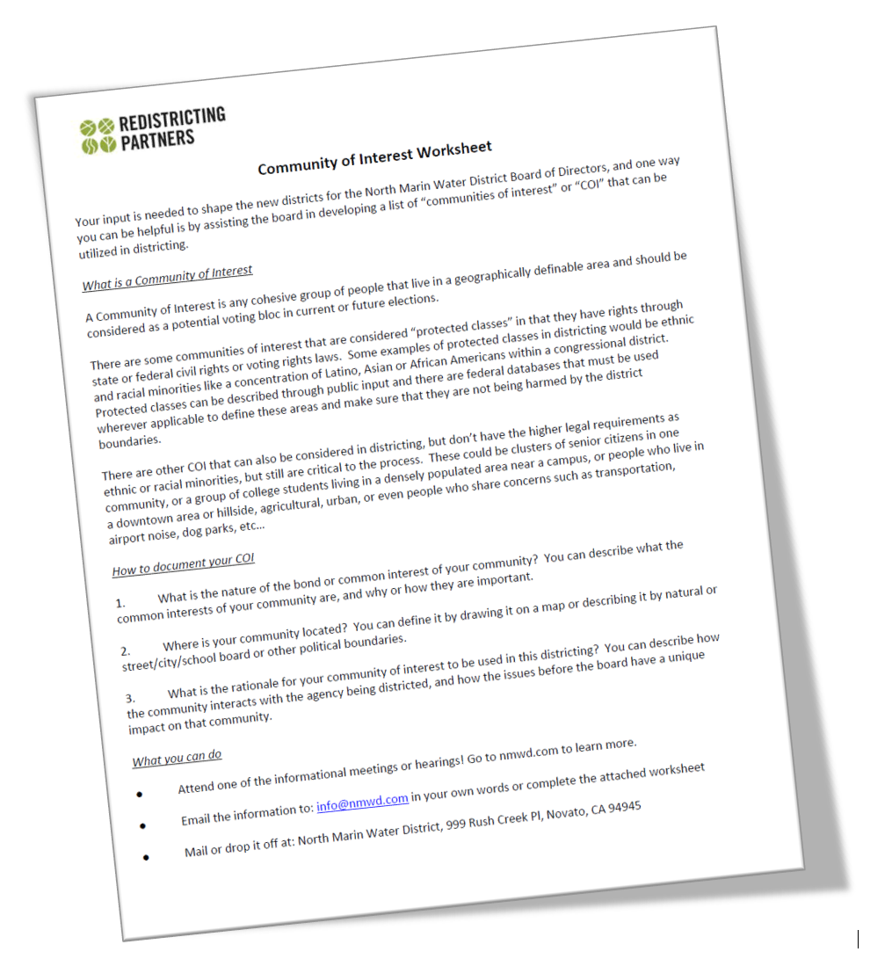
Community of Interest Forms
Submitting Your COI Form
Input can be provided in public hearings or using our “Community of Interest” Worksheet found on the County Redistricting website.
Notes:
On Siskiyou County’s Redistricting page as a webform

Slide 22
Map Submissions
Online Map Submissions will be available in the coming month.
Two types of expected input:
Community of Interest Maps (now – End of Process)
District Plans Based on 2020 Data (Release of Data – Final Adoption)

Slide 23
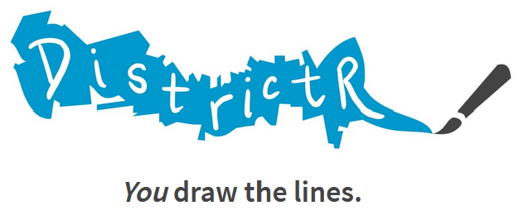
Communities of Interest
Drawing YOUR Communities of Interest
The County of Siskiyou will be using DistrictR as a public mapping tool to allow residents to draw their own Communities of Interest.
https://districtr.org/california
Notes:
Online tool that is very user friendly.
Create COIs, name and describe them, save them – will appear on Siskiyou county’s DistrictR page, where you will be able to see other community members’ maps as well

Slide 24
Communities of Interest
Drawing YOUR Communities of Interest
There will also be paper maps for the public to use to draw their own community of interest.
Notes:
Available at in-person meetings, color coded to easily distinguish between neighborhoods
Will be converted to GIS files so you will be able to view these maps on DistrictR
No matter how you decide to submit you COI, all work received in preserved by the county

Slide 25
Siskiyou County Redistricting Advisory Committee
Timeline for Upcoming Meetings
September 7th Public Hearing
October 5th Board of Supervisors Hearing
October 19th Board of Supervisors Hearing
November 2nd Board of Supervisors Hearing
December 7th Board of Supervisors Hearing (Final Adoption)
Notes:
Sophia

Slide 26
Siskiyou County Redistricting Website
https://www.co.siskiyou.ca.us/redistricting
Notes:
Sophia

Slide 27
Notes:
Include slide on contact information for Paul and Kimi

